Slide 1
Optimal Design for Improving Drag and Cooling Performance of KSAE E-Mobility through CFD Analysis
기계제어공학부
21900416 안견힐
Notes:
Hello, I am An Gyeonhil from the Department of Mechanical and Control Engineering, and I have written a thesis on "Optimal Design for Improving Drag and Cooling Performance of KSAE E-Mobility through CFD Analysis." Let's begin the presentation.

Slide 2
Contents
Research Object
Old Model Analysis & New Model Design
CFD Simulation & Result
Wind Tunnel Experiment Settings & Results
Discussion
Notes:
The table of contents is organized as follows: Research Objective, Old Model Analysis & New Model Design, CFD Simulation & Results, Wind Tunnel Experiment Settings & Results, and Discussion.

Slide 3
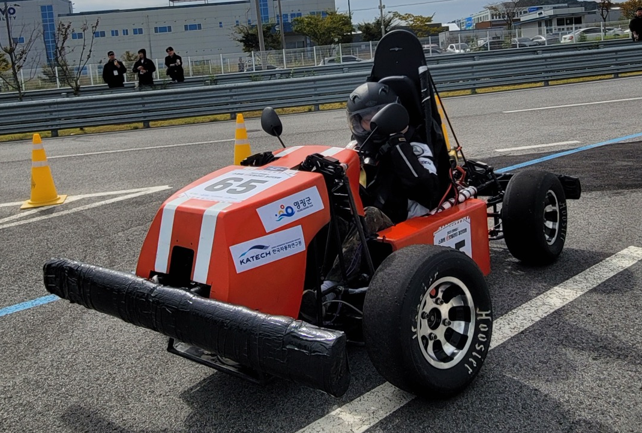
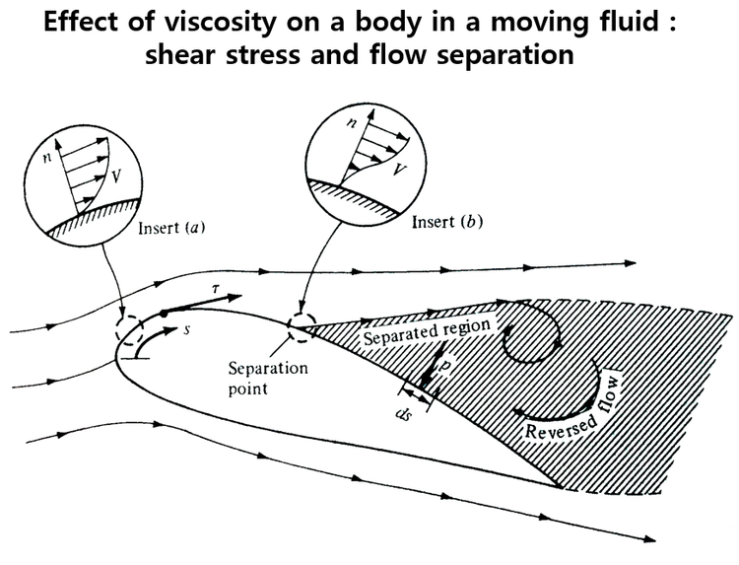
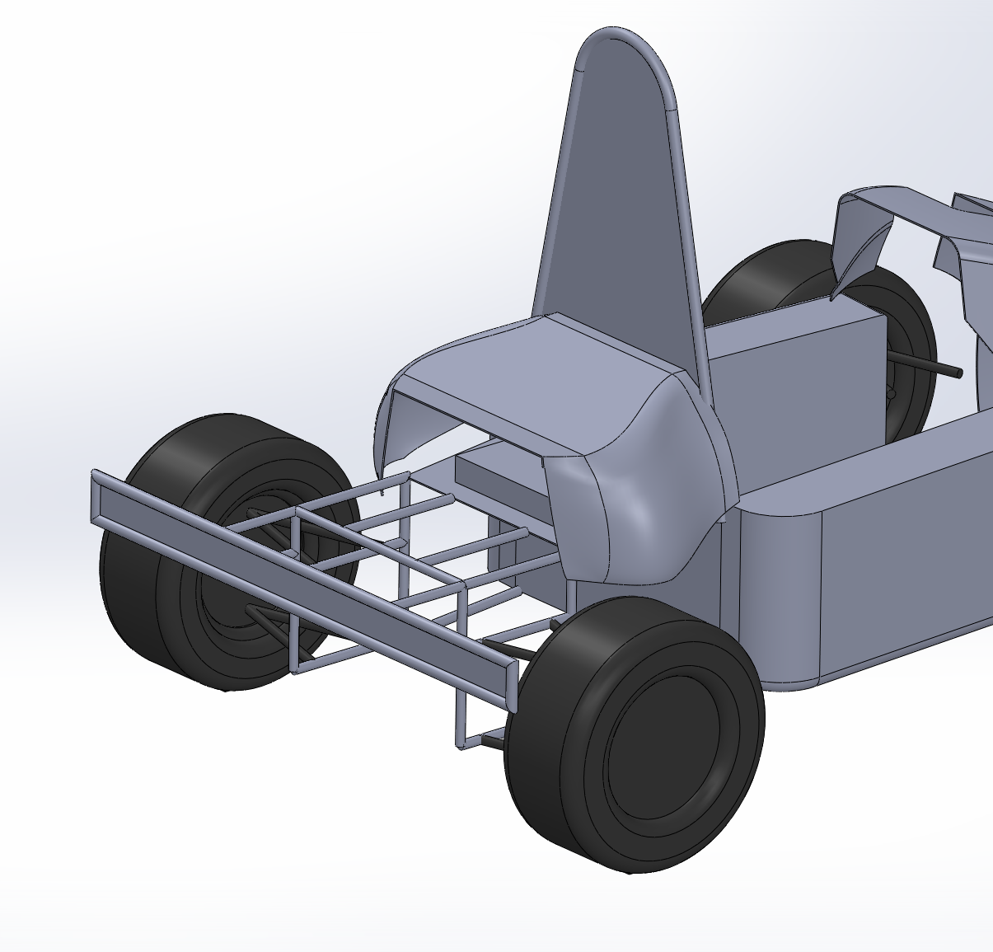
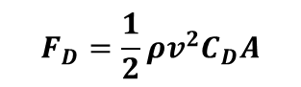
I. Research Object
- CFD analysis of an electric vehicle for the KSAE University Student Electric Car Competition.
1. Drag Reduction
2. Improvement of electronic device cooling performance
Electro Devices
Reduction of projected area
2) Streamline Design
3. Wind Tunnel Experiment
$$F_{D}=\frac{1}{2}ρv^{2}C_{D}A$$
- Compare with CFD Results
Notes:
This thesis aims to improve drag reduction and electronic circuit cooling effect through CFD (Computational Fluid Dynamics) analysis of an electric vehicle for the KSAE (Korean Society of Automotive Engineers) University Student Electric Car Competition. The design of the existing vehicle has high drag and ineffective cooling of the electronic circuits. To solve these issues, a model that minimizes drag and improves electronic circuit cooling using Ansys Fluent is proposed, and wind tunnel experiments are conducted to verify the reliability of the CFD analysis results. The key factors determining vehicle drag are the projected area in the direction of fluid flow, the speed of the fluid, and the drag coefficient due to shape, as shown in this equation. The goal was to minimize drag by designing the vehicle streamlined to lower the drag coefficient (𝐶_𝐷) and reduce the projected area (𝐴) to minimize drag. As shown in the image above, the vehicle was designed streamlined to minimize flow separation and reduce the drag coefficient (𝐶_𝐷) and the projected area (𝐴) to minimize drag.

Slide 4
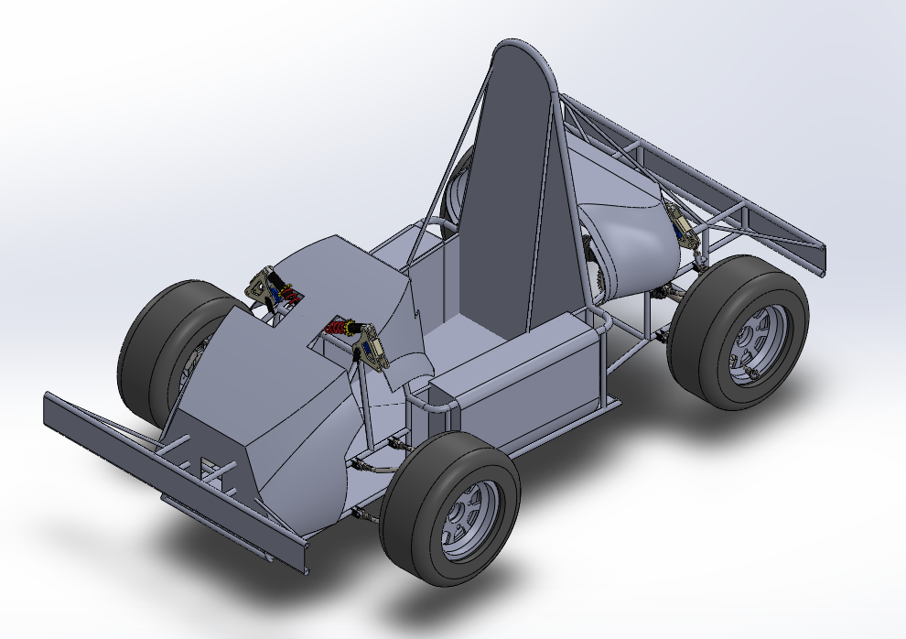
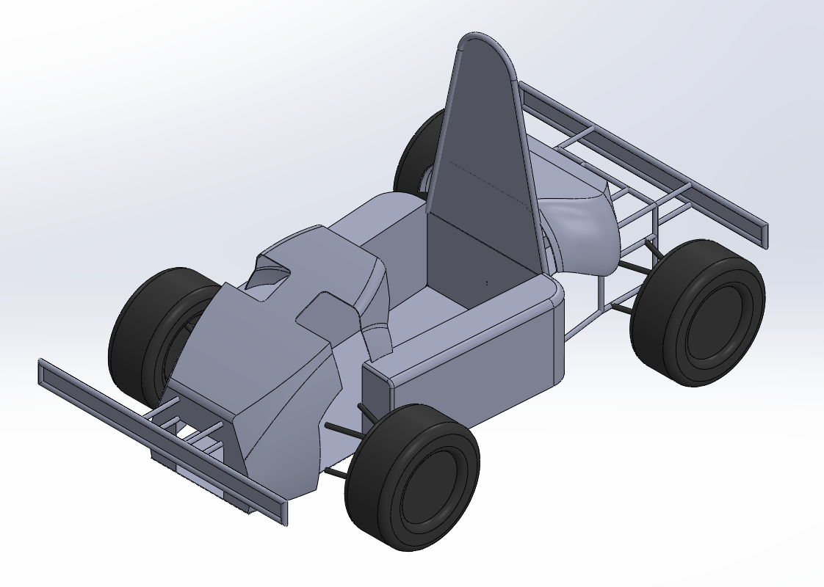
II. Vehicle analysis and modeling – Existing model
Angular cowl shape at the front of the vehicle
Internal flow due to open structure
Large frontal projected area
Ineffective cooling performance of electronic devices in the rear cowl
→ Re-modeling to simplify shapes for easier analysis
Notes:
The existing vehicle that participated in the 2023 KSAE E-Mobility competition was designed without considering aerodynamic aspects. This model has a wide frontal projected area, an open structure at the front cowl causing internal flow, and an overall high drag structure due to its angular design at the front. Additionally, the rear cowl of the existing model does not effectively create airflow to cool the electronic control circuits and devices at the rear of the vehicle. Before conducting the CFD analysis, the 3D model of the existing vehicle was re-modeled. The purpose of this CFD analysis is to compare the drag according to the vehicle's shape, focusing on external rather than internal flow analysis. Therefore, in the re-modeled 3D model, internal components of the vehicle were removed, and complex shapes that could interfere with mesh generation and analysis were simplified. The hollow pipes used in frame construction were changed to solid rods to prevent meaningless enclosures from being created. During the assembly phase, physically impossible contact conditions such as surface-to-surface or surface-to-point contacts were corrected to avoid errors in the enclosure generation phase. Additionally, excessive fillet shapes on the cowl, which could reduce meshing quality, were modified to an extent that would not significantly affect the analysis results.

Slide 5
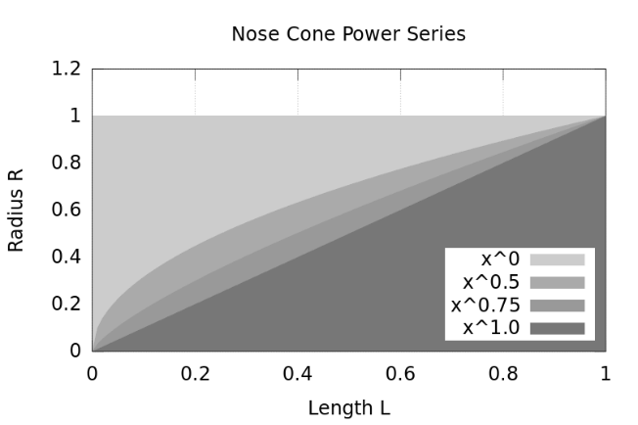
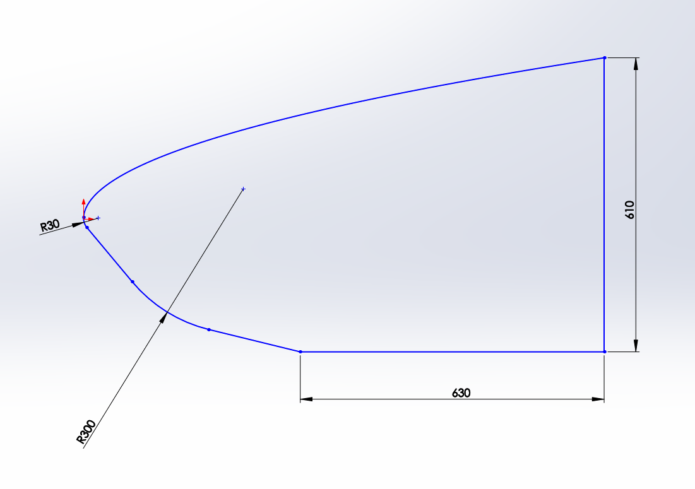
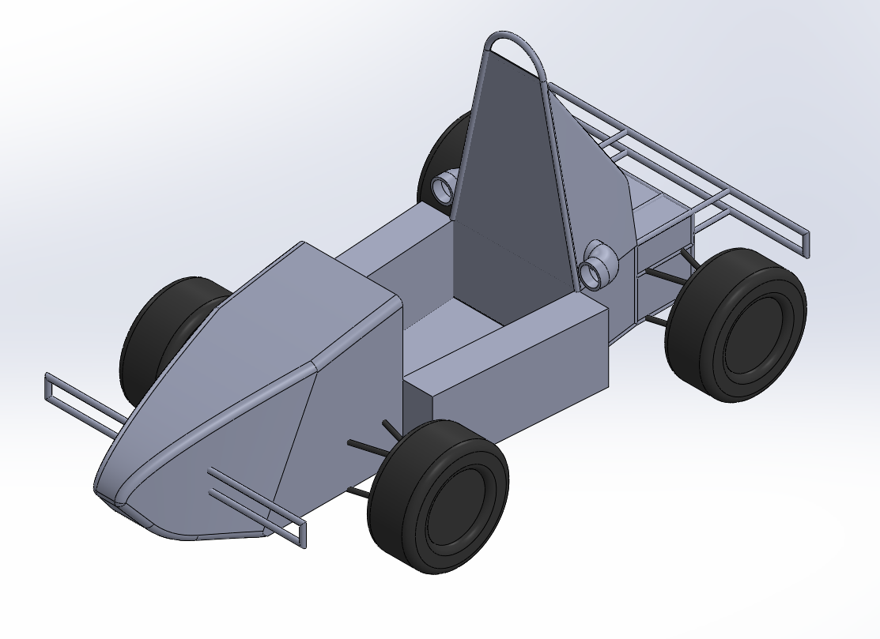
II. Vehicle analysis and modeling – Advanced 1
RRH
Bumper
Air Vent
$$y=R{\left(\frac{x}{L}\right)}^{n} \left\{0≤n≤1\right\}$$
Streamlined design inspired by the "Power 0.5" design in "Rocketry Nose Cone Design“
Air vent design for air cooling effect of electronic devices
Removal of front and rear bumpers and RRH metal plates, which occupy a large portion of the projected area
Sloped rear cowl design to minimize rear vortex region
Notes:
The redesigned model retained the vehicle's frame but modified the front and rear cowls covering the frame. To address the angular design issue of the existing front cowl, the "Power 0.5" formula from the “Rocketry Nose Cone Design” was applied. Furthermore, the front and rear bumper plates, which occupied a large part of the frontal projected area, were partially removed within KSAE regulations. The existing model experienced increased drag due to vortex generation in the empty rear space of the vehicle. To improve this, a sloped rear cowl was designed to minimize the space where vortices form. Additionally, cylindrical air vents were added on both sides of the rear cowl to direct airflow over the rear electronic devices, enhancing air cooling performance.

Slide 6
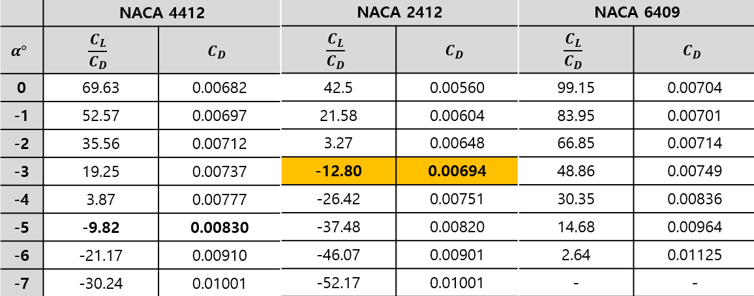
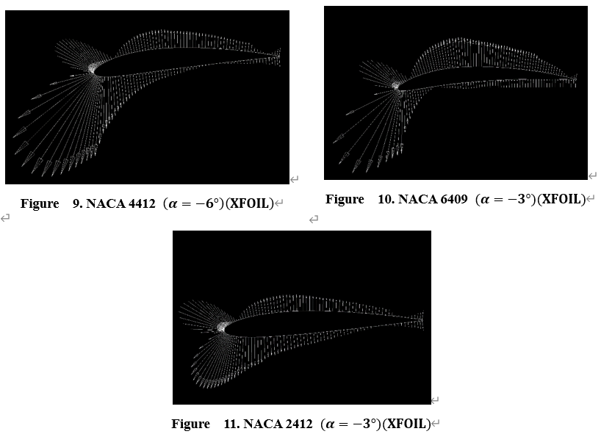
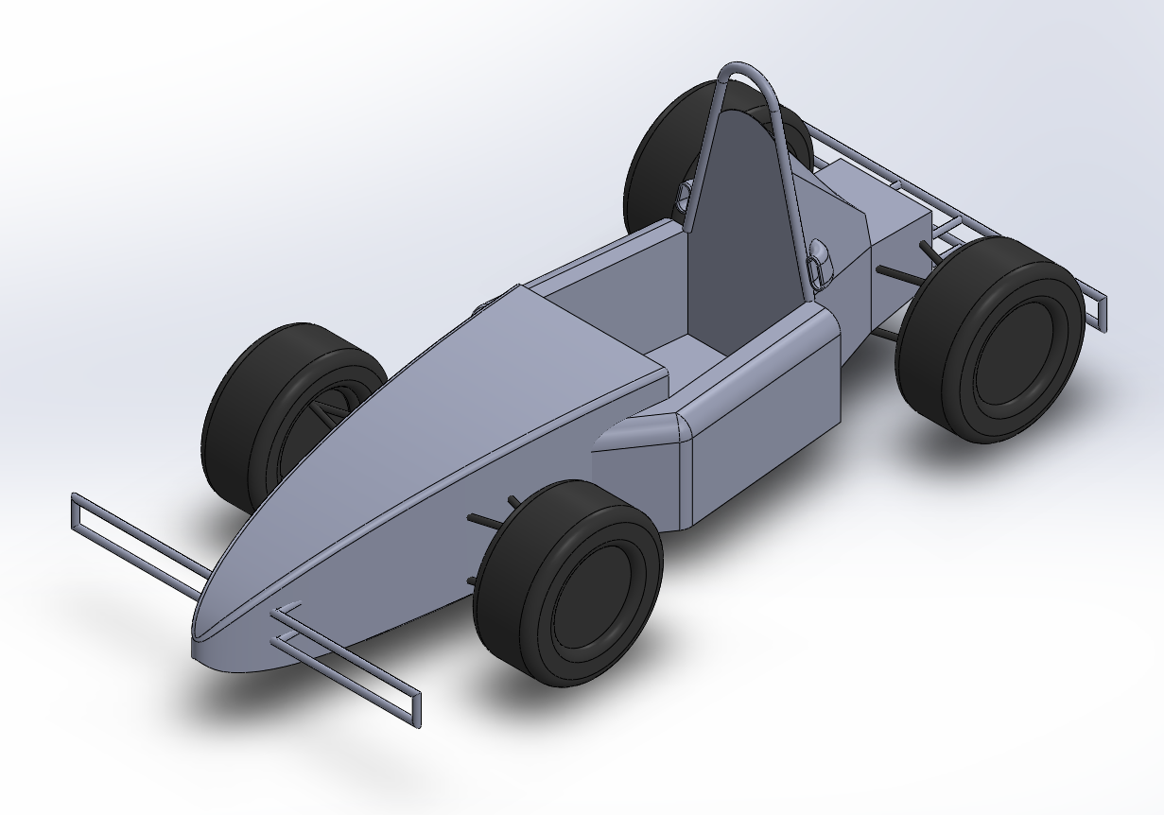
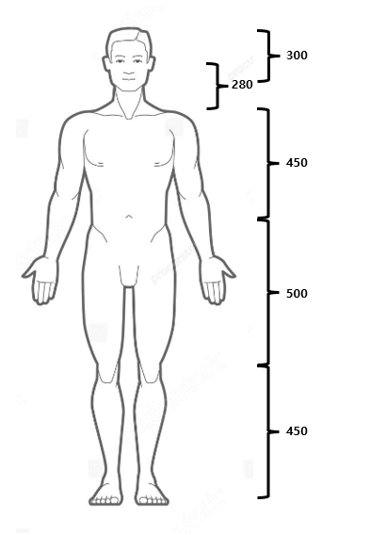
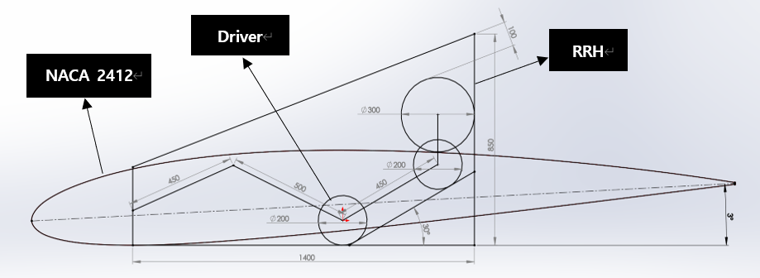
II. Vehicle analysis and modeling – Advanced 2
Changing the driving position of a 170 cm tall adult male from sitting to reclining
→ Lowering the vehicle height to reduce frontal projected area
2. Choosing a NACA airfoil model with a low drag coefficient and negative
lift-to-drag ratio depending on the angle of attack
→ Improving the drag coefficient through streamlined design
Notes:
The second improved model was designed with aerodynamic aspects in mind through changes in the frame structure. To this end, the driving position of a 170cm tall driver was changed from a sitting position to a reclined position at an angle of about 30 degrees, lowering the vehicle height to reduce the frontal projected area. The overall shape of the vehicle was designed based on the streamlined NACA Airfoil to lower the drag coefficient. The vehicle's RRH (Rear Roll Hoop) is a device necessary to protect the driver in the event of a rollover. According to the 2024-KSAE regulations, a line drawn from the RRH to the foremost frame must maintain a distance of more than 100mm from the driver's head. Considering this, the frontal projected area was reduced by lowering the driver’s position by 350mm compared to the existing vehicle while ensuring that the driver had a clear forward view and no discomfort in driving. The airfoil used for the overall design of the vehicle was chosen from three airfoil models: NACA 4412, NACA 2412, and NACA 6409. These airfoil models, known for their low drag characteristics, are used in various components such as the front end, roofline, spoiler, and wing of commercial vehicles, as well as in aircraft. The optimal airfoil model and angle of attack (AOA) for the vehicle design were found by comparing the lift-to-drag ratio and drag coefficient of the three airfoils as the angle of attack changed. The CFD software used for this was XFOIL, which has the advantage of fast computation speed by using the potential flow analysis method and a simplified 2D physical model. The table below shows the lift-to-drag ratio and drag coefficient obtained with XFOIL at different angles of attack, and the figure shows the pressure distribution at different angles of attack for each airfoil model in vector form. When the angle of attack was changed from 0° to 7°, the model with the lowest drag coefficient and negative lift-to-drag ratio was NACA 2412 (𝛼=−3°). The more negative the lift coefficient, the greater the downforce during driving, which increases traction and improves motor power delivery and cornering stability. However, compared to the downforce due to the vehicle's weight (-2452.5N), the shape-induced downforce does not bring significant changes, so the focus was on the low drag coefficient to determine the airfoil model. The air vents of the improved Model 2’s rear cowl were designed as ellipses to allow fluid to pass through narrow passages.

Slide 7
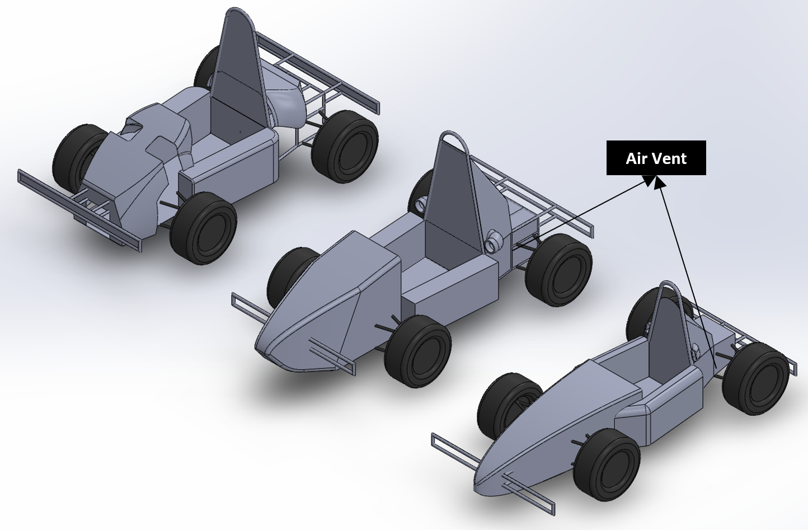
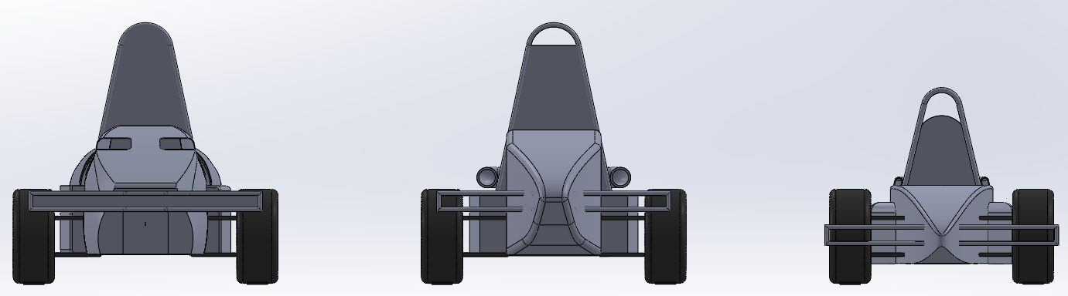
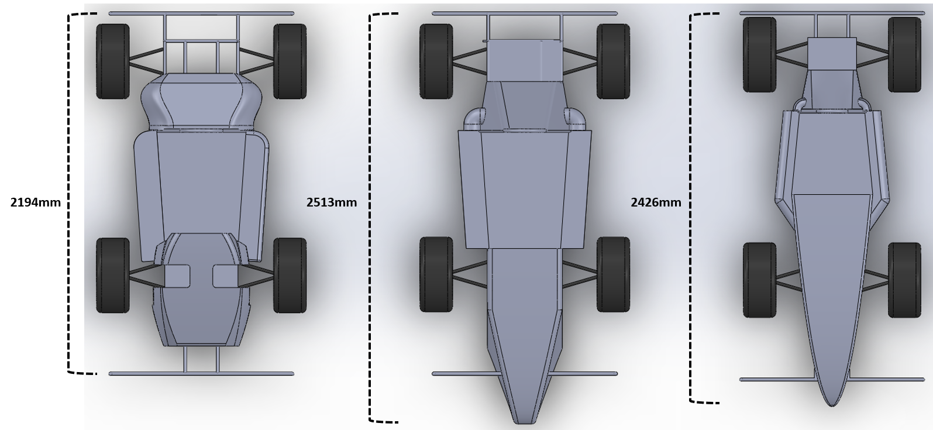
II. Vehicle analysis and modeling – Model Comparison
Original
Advanced 1
Advanced 2
→ Reduction of frontal projected area, overall streamlined vehicle design
Notes:
The models designed through the above improvements are shown in the photo above. The angular design of the existing model was improved with an overall streamlined design, and as can be seen in the table, the frontal projected area was significantly reduced.

Slide 8
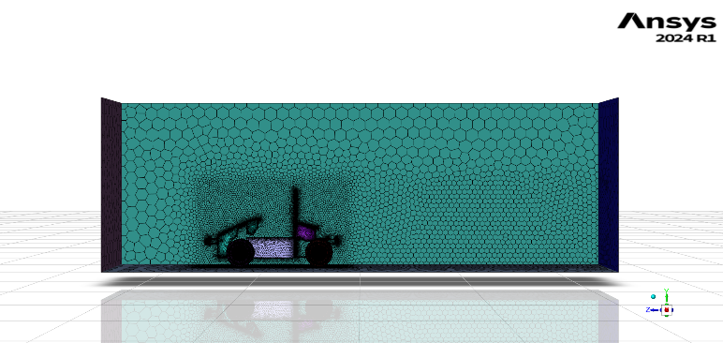
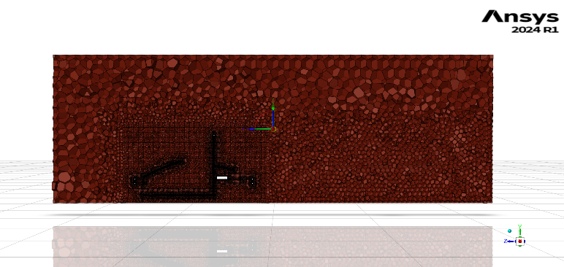
III. CFD Simulation – Mesh Condition
Surface Mesh
Volume Mesh
→ 2,580,000 Cells
Notes:
Setting appropriate mesh conditions in CFD analysis shows high accuracy in the analysis. Surface mesh, volume mesh, and boundary layer conditions were set with appropriate types and sizes according to the characteristics of each area of the vehicle. The BOI (Boundary of Interest) is a zone set to accurately analyze the fluid flow around the vehicle, with BOI-nearfield set to 40mm and BOI-farfield set to 90mm. To enable accurate fluid flow analysis of complex curved surfaces such as pipes and cowls, the curvature type was used.

Slide 9
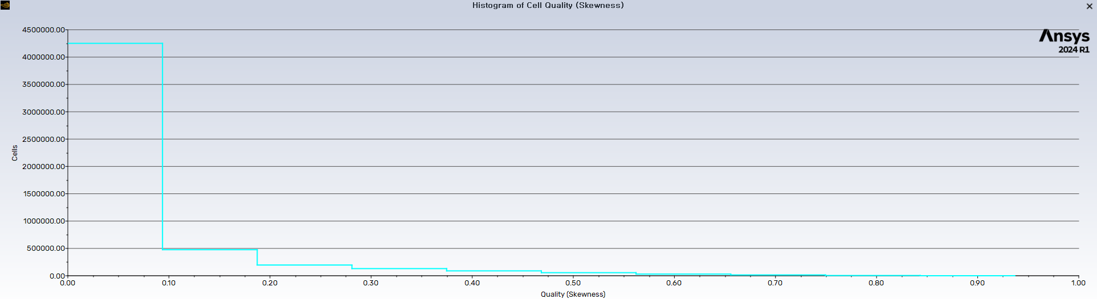
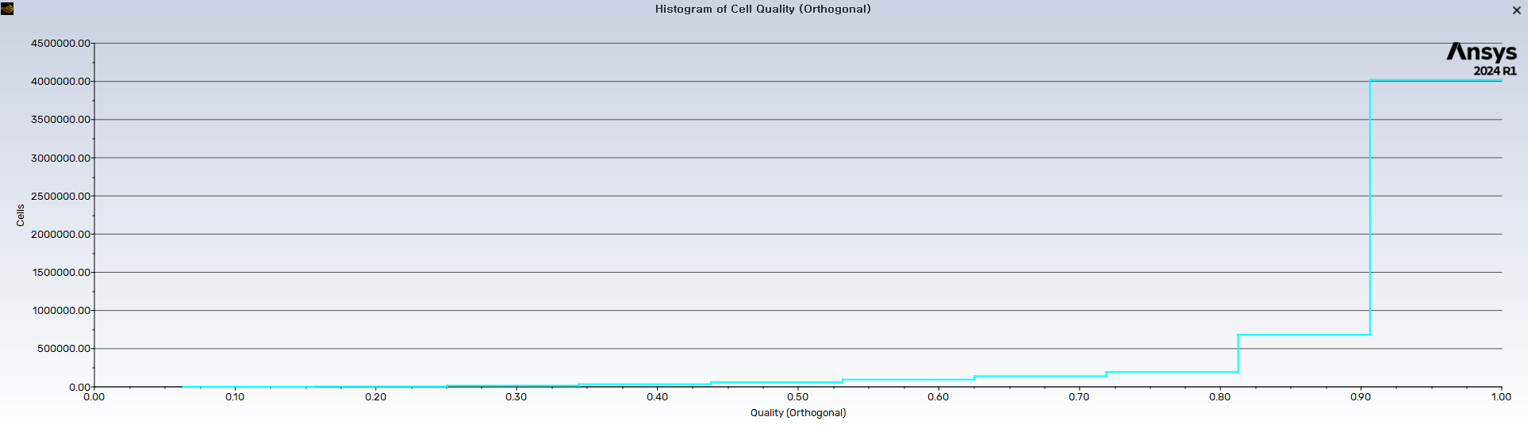
III. CFD Simulation – Mesh Quality & Convergence
Skewness Quality
Mesh Convergence
Orthogonal Quality
→ 1.3% Difference
Notes:
The graph below shows the skewness and orthogonal characteristics to assess the quality of the mesh. Skewness indicates how distorted a cell is from the ideal shape (cube). The closer the skewness value is to 0, the closer it is to the ideal shape, while a value closer to 1 indicates severe distortion and low mesh quality. Low skewness values are often seen in 3D models with sharp edges or excessive fillets. Orthogonal quality indicates how close the cell's edge angles are to 90 degrees. The closer the orthogonal value is to 1, the higher the mesh quality, while a value closer to 0 indicates low mesh quality. The chart below shows the skewness and orthogonal values for each cell. Small mesh sizes can result in exponentially high computational costs. Therefore, a mesh convergence process was performed to find the appropriate mesh size. This process involves repeating the analysis with various mesh sizes under the same conditions to ensure mesh convergence, meaning less than a 5% difference indicates an appropriate mesh size. As shown in the chart below, a 1.3% difference was observed between using larger mesh sizes and the conditions in the table, indicating that the mesh size conditions in the table are appropriate. The total number of cells was 2,580,000.

Slide 10
III. CFD Simulation – Boundary Conditions and Turbulence Model
Spalart - Allmaras VS SST $k−ω$
Advantageous for external flow analysis
Use of a single transport equation
-> Low computational cost
Specialized in boundary layer flow analysis
Advantageous for internal flow analysis
Use of two transport equations
-> High computational cost
Specialized in estimating viscosity coefficients in complex fluid flows
→ Spalart - Allmaras
Notes:
The boundary conditions set for the analysis are shown in Table 4. These were set assuming the vehicle was moving at a constant speed of 72 km/h, the top speed of the 2023-KSAE competition, with the wheels set to rotational motion and the tunnel walls set to no shear stress. The turbulence model used for the analysis was Spalart-Allmaras, which uses a single transport equation instead of the two transport equations of the SST 𝑘−𝜔 model, resulting in lower computational costs and being specialized in predicting boundary layer flow and external flow. This model is advantageous for calculating drag according to vehicle shape and shows high accuracy suitable for the research purpose at a lower computational cost.

Slide 11
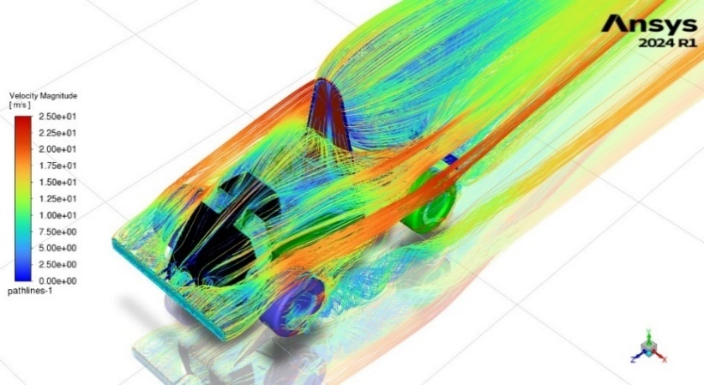
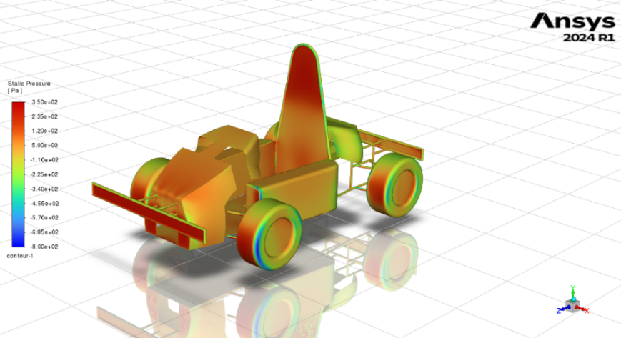
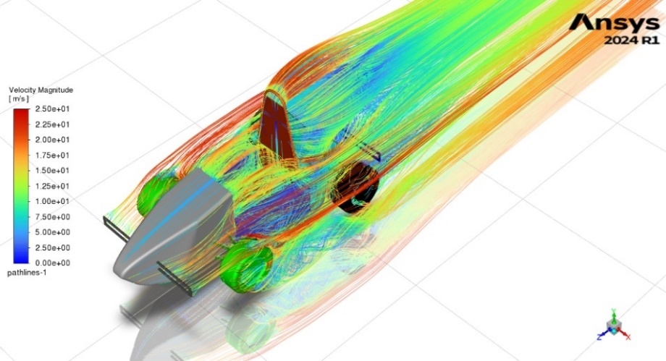
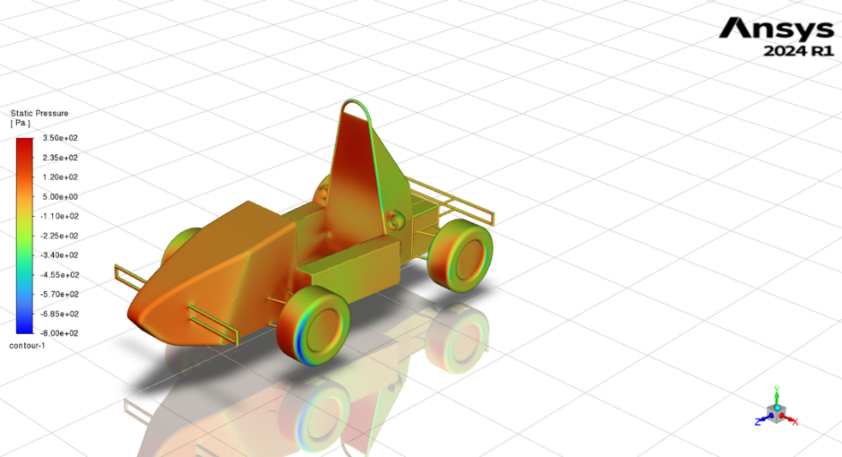
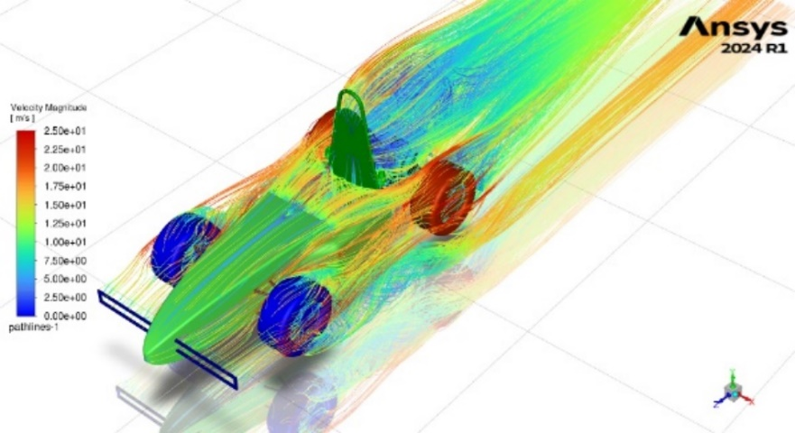
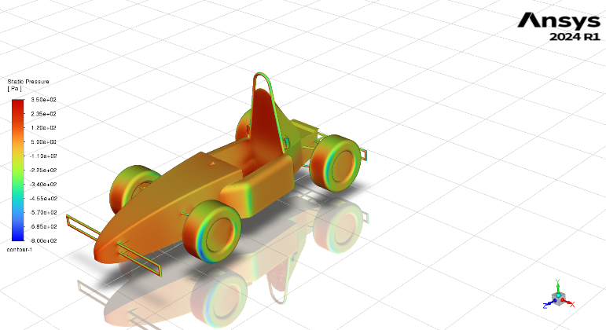
III. CFD Solution – Drag Performance
20.4%, 43% Drag Force Reduction
17%, 21% Drag Coefficient Reduction
Notes:
The CFD analysis results, applying the above analysis conditions, showed drag forces of 245[N] for the existing model, 195[N] for Improved Model 1, and 140[N] for Improved Model 2. The drag coefficients were 1.24 for the existing model, 1.03 for Improved Model 1, and 0.98 for Improved Model 2. Improved Model 1 and Improved Model 2 achieved drag reductions of 20.4% and 43% compared to the existing model, with drag coefficients improved by 17% and 21%, respectively.

Slide 12
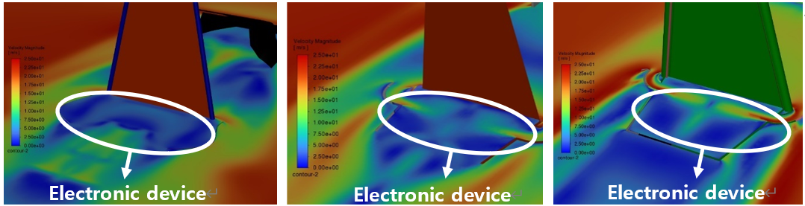
III. CFD Solution – Cooling Performance
Old Model
Advanced 1
Advanced 2
2.5 [m/s] < 10 [m/s] < 16 [m/s]
Fluid accelerated through the narrow passage of the air vent is cooled and flows directly over the electronic devices
Improved cooling performance of electronic devices using air cooling
Notes:
Installing air vents to improve the cooling performance of electronic devices resulted in fluid passing through the narrow passages of the air vents, with a 13.5[m/s] faster and cooler fluid flow compared to the existing vehicle, confirming improved cooling performance due to air cooling.

Slide 13
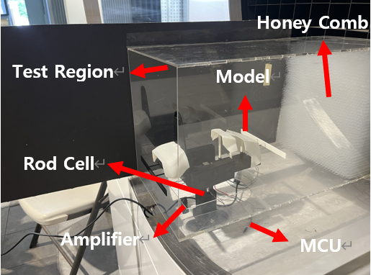
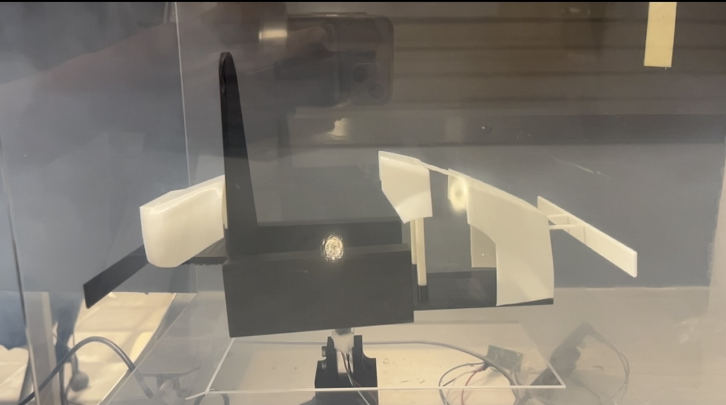
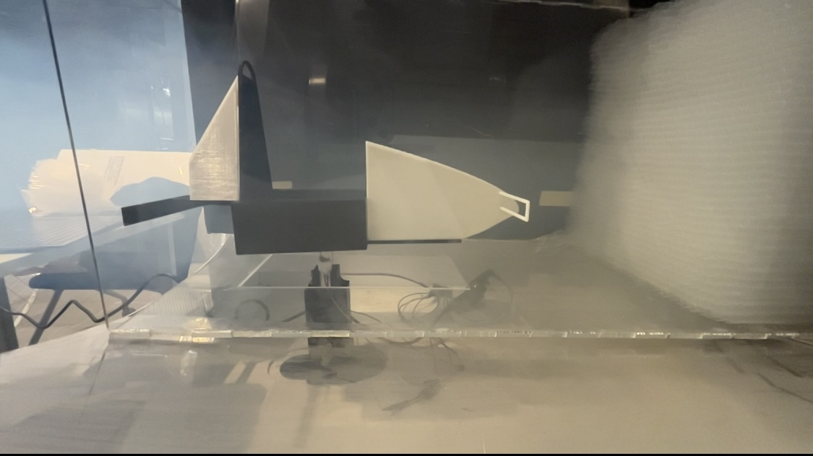
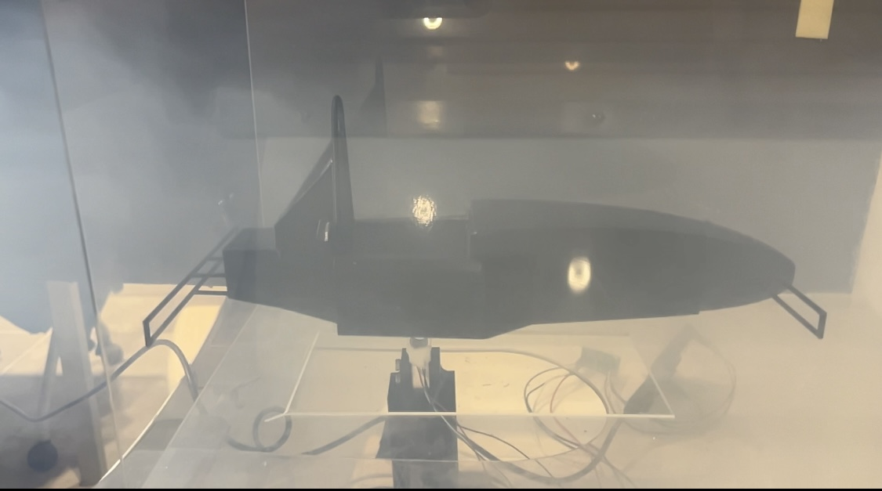
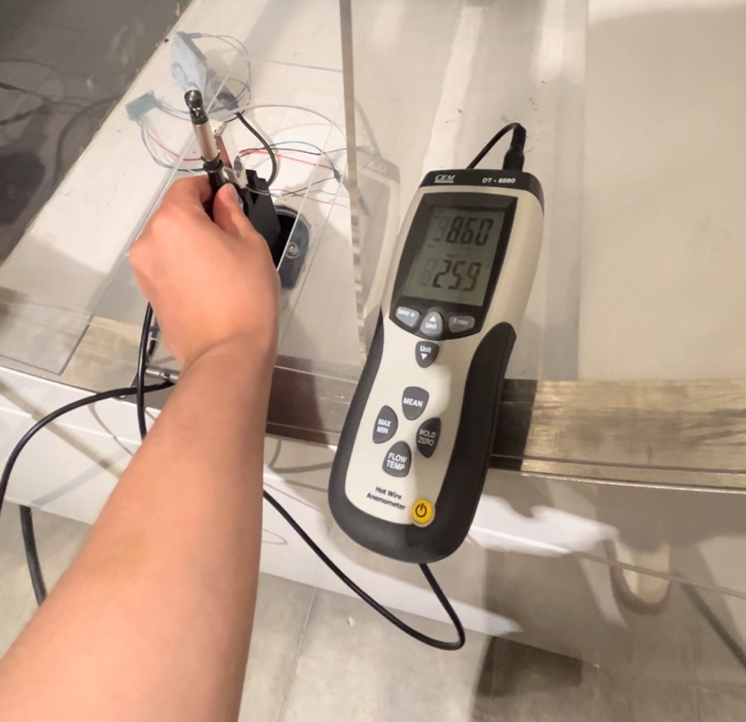
IV. Wind Tunnel Experiment - Settings
Fabrication of a honeycomb structure (transparent straw) to convert turbulent air at the inlet into laminar flow
Creation of a test region (acrylic board) to prevent interference from external fluid
Rod cell → Amplifier → MCU
Notes:
The goal of this experiment was to verify the simulation results. The wind speeds when the wind tunnel fan rotates at 25Hz, 30Hz, and 35Hz, and the drag forces of the existing model, Improved Model 1, and Improved Model 2 at these wind speeds were measured and compared to the simulation results. The components and sensors used in the wind tunnel experiment are detailed in Table 5. Due to the size limitations of the wind tunnel relative to the model size and the limitations of 3D printing, a separate test region was set. An acrylic board was processed to create a defined area where the same wind speed could be maintained within the test region. The Honeycomb structure converts the turbulent

Slide 14
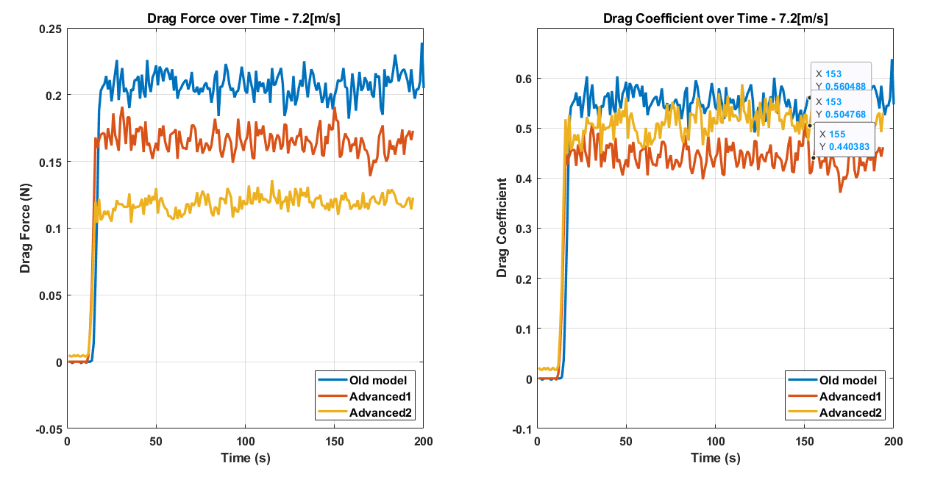
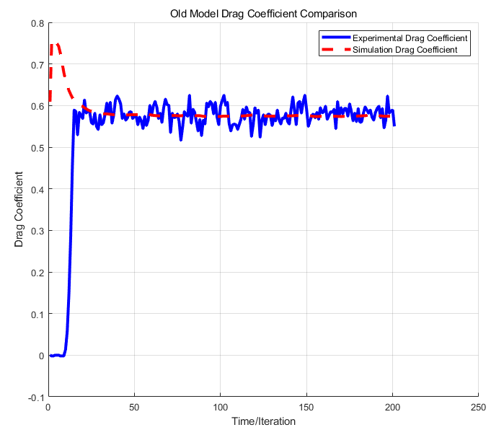
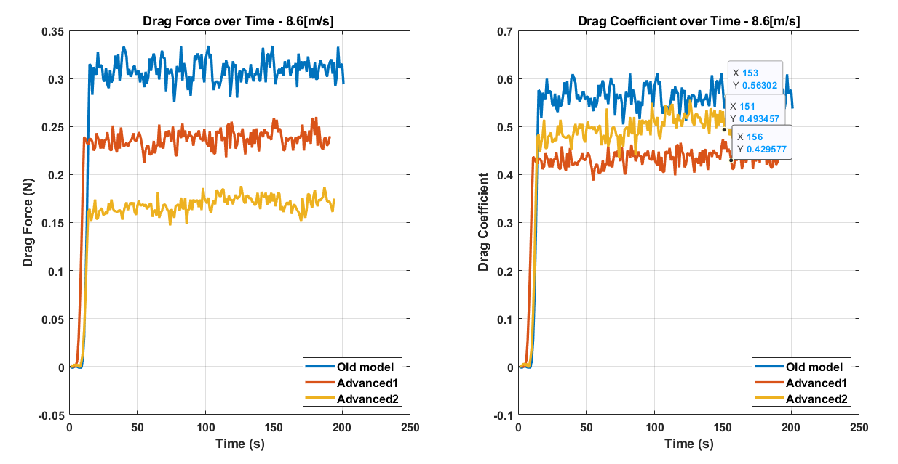
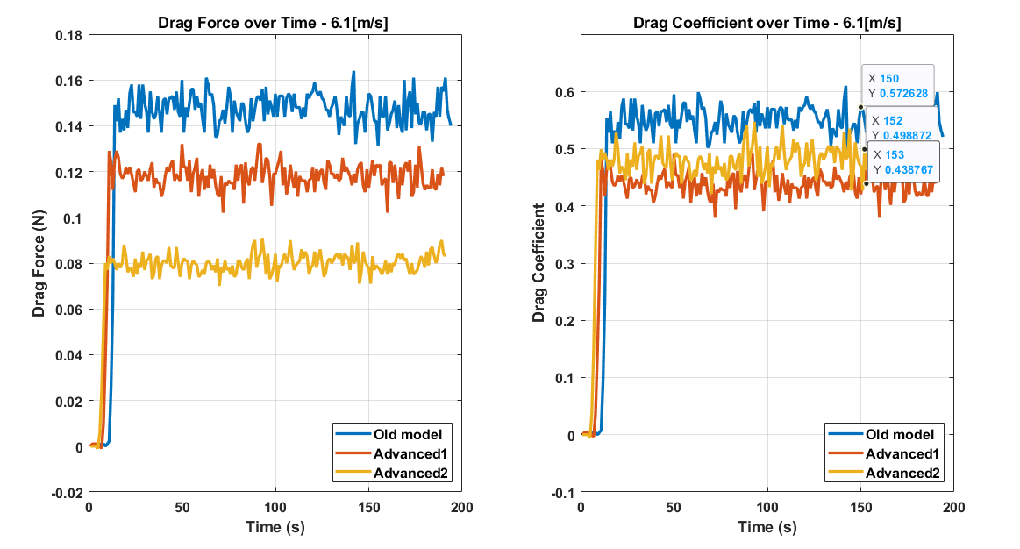
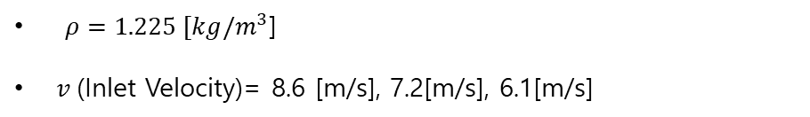
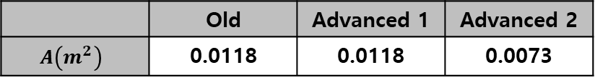
IV. Wind Tunnel Experiment - Result
 | Old | Advanced 1 | Advanced 2
$$A\left(m^{2}\right)$$ | 0.0118 | 0.0118 | 0.0073
The experimental results closely match the CFD analysis results.
The drag coefficient of each model remains constant at three different wind speeds.
$ρ=1.225 [kg/m^{3}$]
$v$(Inlet Velocity)= 8.6 [m/s], 7.2[m/s], 6.1[m/s]
→ This indicates that the experimental design and analysis conditions have been correctly set.
Notes:
The wind speeds at 35[Hz], 30[Hz], and 25[Hz] rotation of the wind tunnel fan were 8.6[m/s], 7.2[m/s], and 6.1[m/s], respectively. The frontal projected areas of the existing model, Improved Model 1, and Improved Model 2 printed with a 3D printer were measured in Ansys Space Claim and found to be 0.0118[m^2], 0.0118[m^2], and 0.0073 [m^2], respectively. The air density was set to the standard air density of 1.225 [kg/m^3]. Using these values and the drag force obtained from the experiment, the drag coefficient of each model was calculated and plotted (Figures 28, 29, 30). To calculate the analysis error between the simulation and experiment, the model used in the experiment was analyzed under the same conditions as the previous simulation. The drag coefficients obtained from the simulation and experiment are shown in Figure 31.

Slide 15
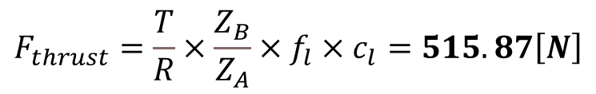
V. Discussion
$$F_{thrust}=\frac{T}{R}×\frac{Z_{B}}{Z_{A}}×f_{l}×c_{l}=515.87\left[N\right]$$
A reduction of 105 N in drag force constitutes a significant proportion when compared to the motor's thrust.
Since drag is proportional to the square of speed, the reduced drag coefficient and frontal projected area can lead to higher performance at high speeds.
This results in high acceleration performance, reduced time to reach top speed, and an increase in top speed.
The fast and low-temperature fluid flow improves the cooling performance of electronic devices through air cooling.
Despite the sensitivity limitations of the load cell and disturbances caused by inconsistent wind speeds, the CFD analysis conditions have been validated.
Notes:
Compared to the angular shape of the existing vehicle, Improved Models 1 and 2, designed with a streamlined shape, showed drag coefficient improvements of 17% and 21%, respectively, and had lower drag due to the smaller frontal projected area. The improved drag was compared to the thrust calculated for vehicles participating in the KSAE competition using the information in Table 6. The vehicle's thrust can be calculated using the equation below. This shows that the reduced drag of 105[N] significantly affects the vehicle's driving performance. To ensure the reliability of the CFD analysis conditions, the wind tunnel experiment results were compared with the simulation results. Despite the limitations of the load cell sensor and the inconsistency of wind speeds causing disturbances in the experimental values, it was confirmed that there was no significant difference between the experimental and simulation results (Figure 31), indicating that the CFD analysis conditions were correctly configured. Furthermore, as shown in Figures 28, 29, and 30, the consistent drag coefficients of each model despite changes in wind speed entering the inlet indicate that the experimental design was correctly done.
The vehicle from the last competition had a drag force of 245[N] at 72[km/h] due to its angular shape and large projected area. The improved models, designed with a streamlined shape and improved large areas, achieved a drag reduction of 105[N] compared to the existing model. The reduced drag can shorten the time to reach the top speed and increase the top speed, as drag is proportional to the square of the vehicle's speed. Therefore, reducing the frontal projected area and drag coefficient maximizes the driving performance advantage. Although the regulations related to RRH limited the reduction of the frontal projected area and drag coefficient, continuous research could lead to even better performance.

Slide 16
Thank you

